Slide 1
Computer Management Part 1

Slide 2
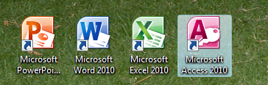
Computer Management
Shortcuts
A Shortcut is a icon that works like a link to a specific program, file or folder

Slide 3
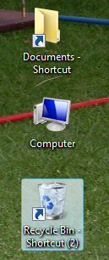
Shortcuts
The following shortcut icons will be found on desktop whereafter you can add your own.
My Documents
My Computer
Recycle BIn

Slide 4
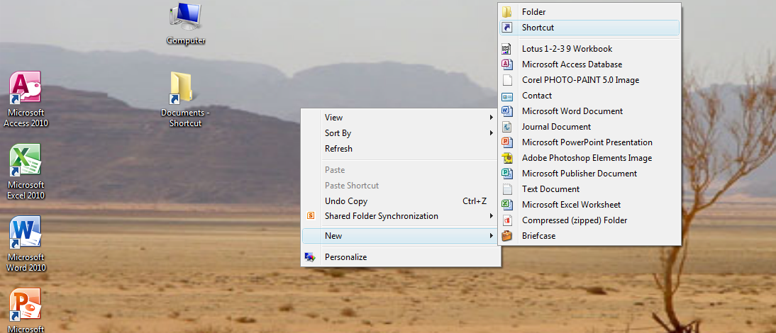
Shortcuts
Creating Shortcuts
Right-click on desktop and choose New from menu, Select Shortcut, Browse to the folder you want to be a shortcut and enter the name

Slide 5
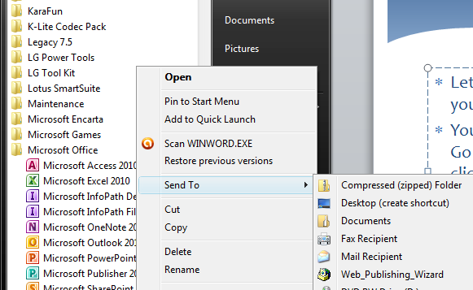
Shortcuts
Lets say you want Microsoft Excel to appear as an Icon on your desktop.
Click on start button, Choose All Programs, Go down to Micrsoft Office, Click on it, Now right-click on Microsoft Excel and choose „sent to – Desktop”

Slide 6
Screen Shots
Screenshots
A Screenshot is an image of your computer screen
Press the PrintScreen (PrtSc) button on your keyboard.
Open a word document or PowerPoint and simply paste (Ctr + V) and the sreen image will appear

Slide 7
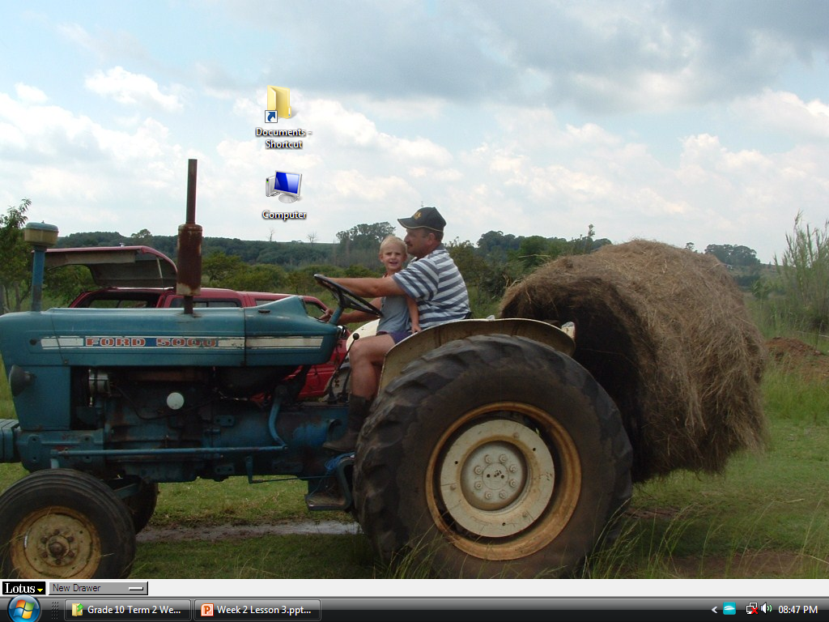
Computer Managment
The result of taking a screenshot of your Desktop

Slide 8
Compressing files and Folders
Compres or Zip a folder to make it smaller maybe for sending with email.
First find the file or folder that you want to compress, click right on the folder and choose send to and then compressed file.

Slide 9
Decompressing files and folders
Decompres or UnZip a folder to change it back to its original size or simply to open it so that you can acces the file again.
First find the file or folder that you want to decompress, double click on it and it will open.

